Slide 1
Containerization basics using Docker

Slide 2
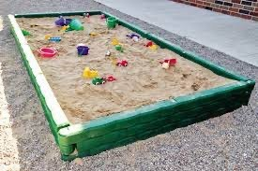
Containerization
A way to package application with all the necessary dependencies and configuration.
Portable artifact, easily shared and moved around.
This makes development and deployment more efficient.

Slide 3
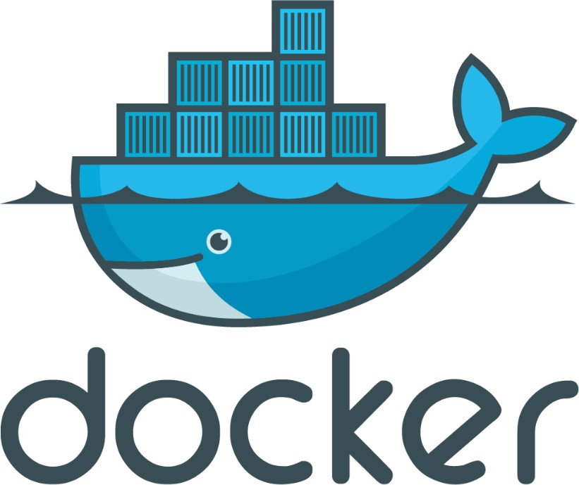



Containerisation
A system that allows multiple isolated operating systems to run inside a larger, host system.
The most basic type of containerization is chroot, which runs an application in a jail where it cannot see or access anything outside of its jail
The most popular container technologies are Docker and Singularity

Slide 4
How containers improved Application Development
Before Containers
With Containers
Install all dependencies on your local machine.
Installation process different on each OS environment.
Many steps where something could go wrong
Own isolated environment
Packaged with all needed configuration
One command to install the app
Run same app with 2 different versions

Slide 5
How containers improved Application Deployment
Before Containers
With Containers
Developer create the artifact + instructions on how to configure this artifacts on the server.
Send it to Operations team.
configuration on the server needed
Some conflicts in the dependencies version
textual guide of deployment may get to misunderstandings.
Developers and Operations work together to package the application in a container.
No environmental configuration needed on server
Only need to install Docker Runtime

Slide 6
Docker
An open platform for developing, shipping, and running applications.
Docker separates your applications from your infrastructure

Slide 7
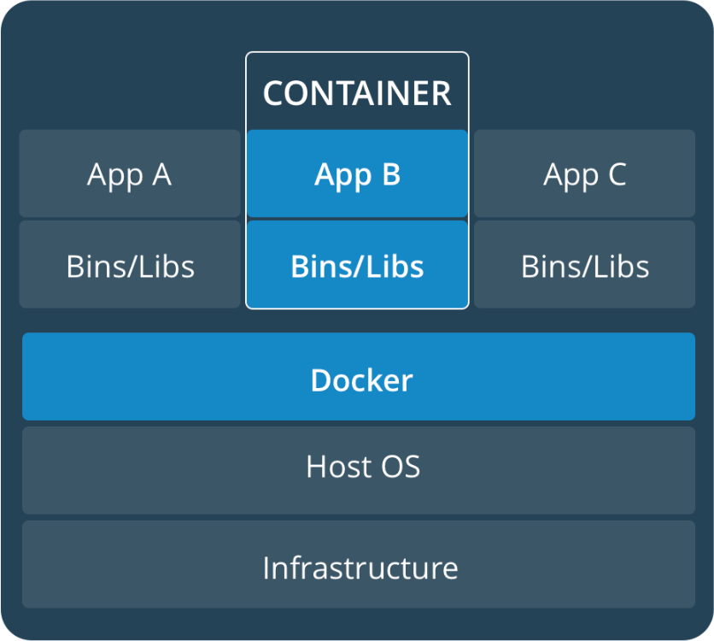

Slide 8
What are Docker's benefits?
Isolation
Efficiency
Scalability
Portablity
Resource utilization
Version control and Rollbacks
Security
Cost-effectiveness

Slide 9
Containerization Use-cases
Analysis pipelines with many runtime tools (Python, Perl, etc) and many packages (Minimap, Samtools, GATK)
Snakemake, NextFlow,
Web applications that need proxy server, databases and application code within a consitent operating environment
Galaxy.,

Slide 10
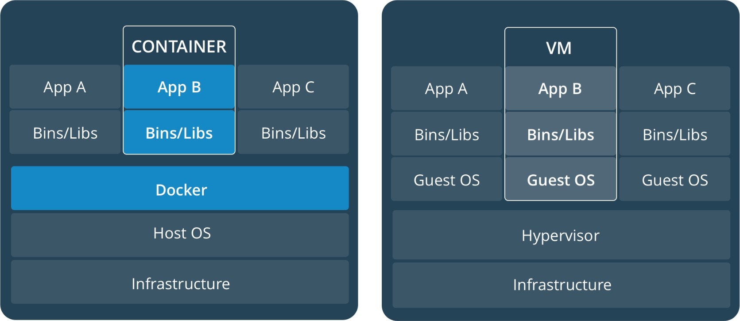
Docker or Virtual machines?
Virtual are not lightweight
Virtual machines package the entire guest OS.
Docker uses the host kernel and a minimal OS that can be shared between containers
Courtesy: https://www.melbournebioinformatics.org.au/tutorials/tutorials/docker/media/#10

Slide 11
Terminology
Image - a lightweight, stand-alone, executable package of a piece of software that includes everything needed to run it: code, runtime, system tools, system libraries, settings
Container - A running image
Several containers can run the same image
Host – the machine running docker on which images and containers are stored and running

Slide 12
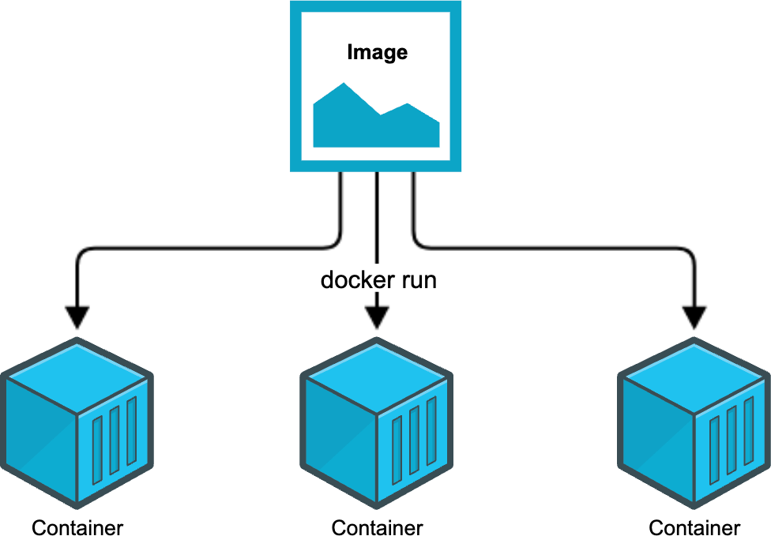
Courtesy: https://www.melbournebioinformatics.org.au/tutorials/tutorials/docker/media/#10

Slide 13
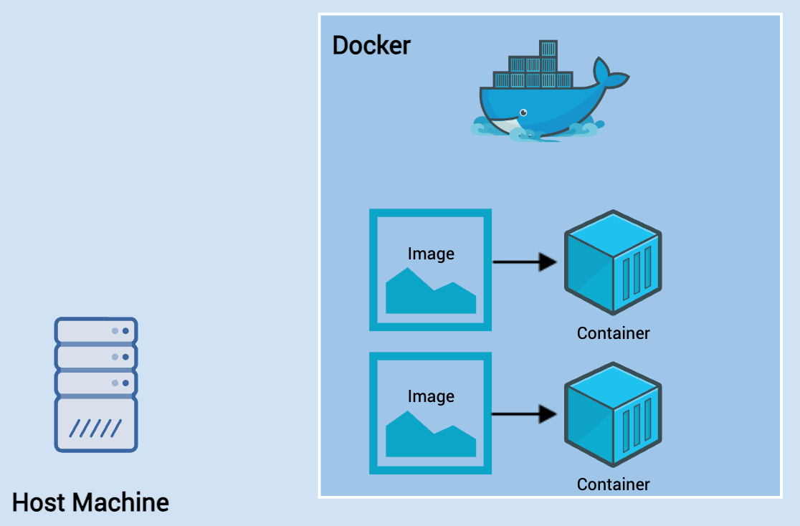
Courtesy: https://www.melbournebioinformatics.org.au/tutorials/tutorials/docker/media/#10

Slide 14
Installing docker
Instructions to get started with docker:
https://docs.docker.com/get-docker/
Docker hub is a registry for docker containers:
https://hub.docker.com/

Slide 15
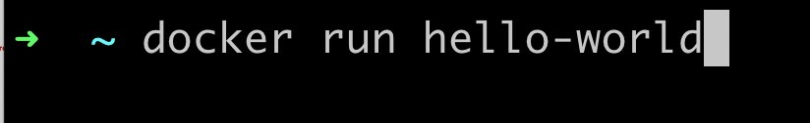
Running docker
To run a container, you specify the image name to docker run
command – docker will pull the image from dockerhub.
docker run image-name

Slide 16
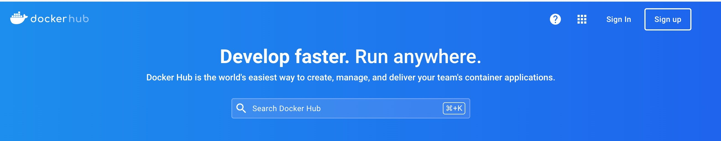
Docker hub
A cloud registry of images
https://hub.docker.com/

Slide 17
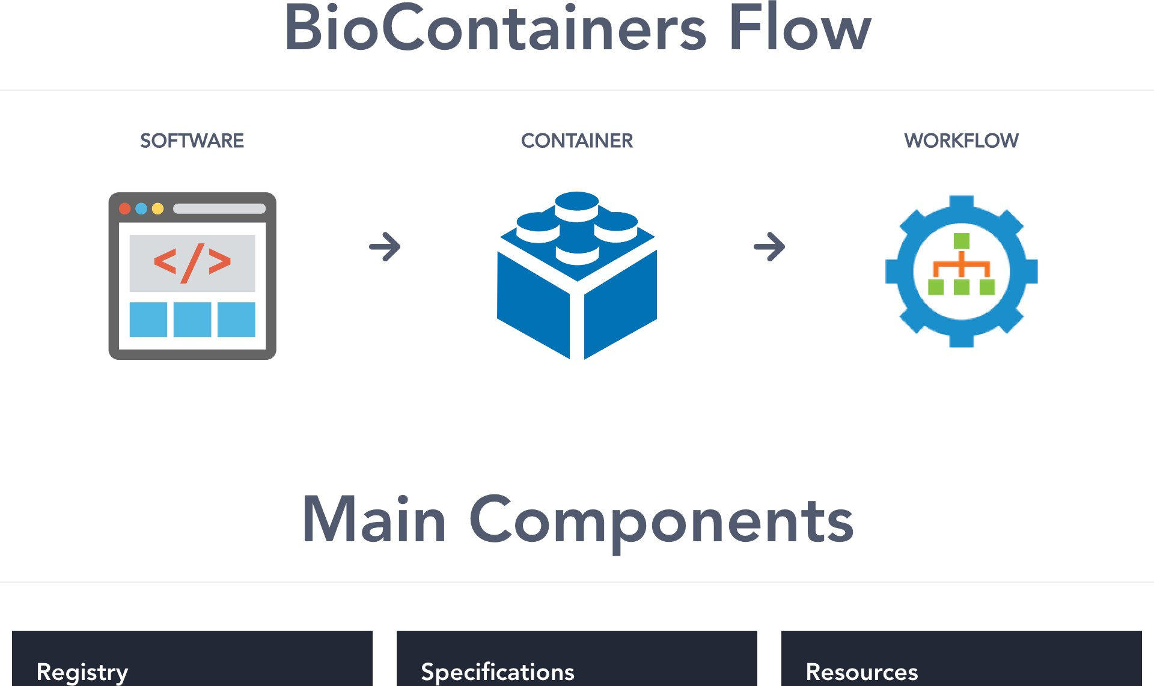

Slide 18
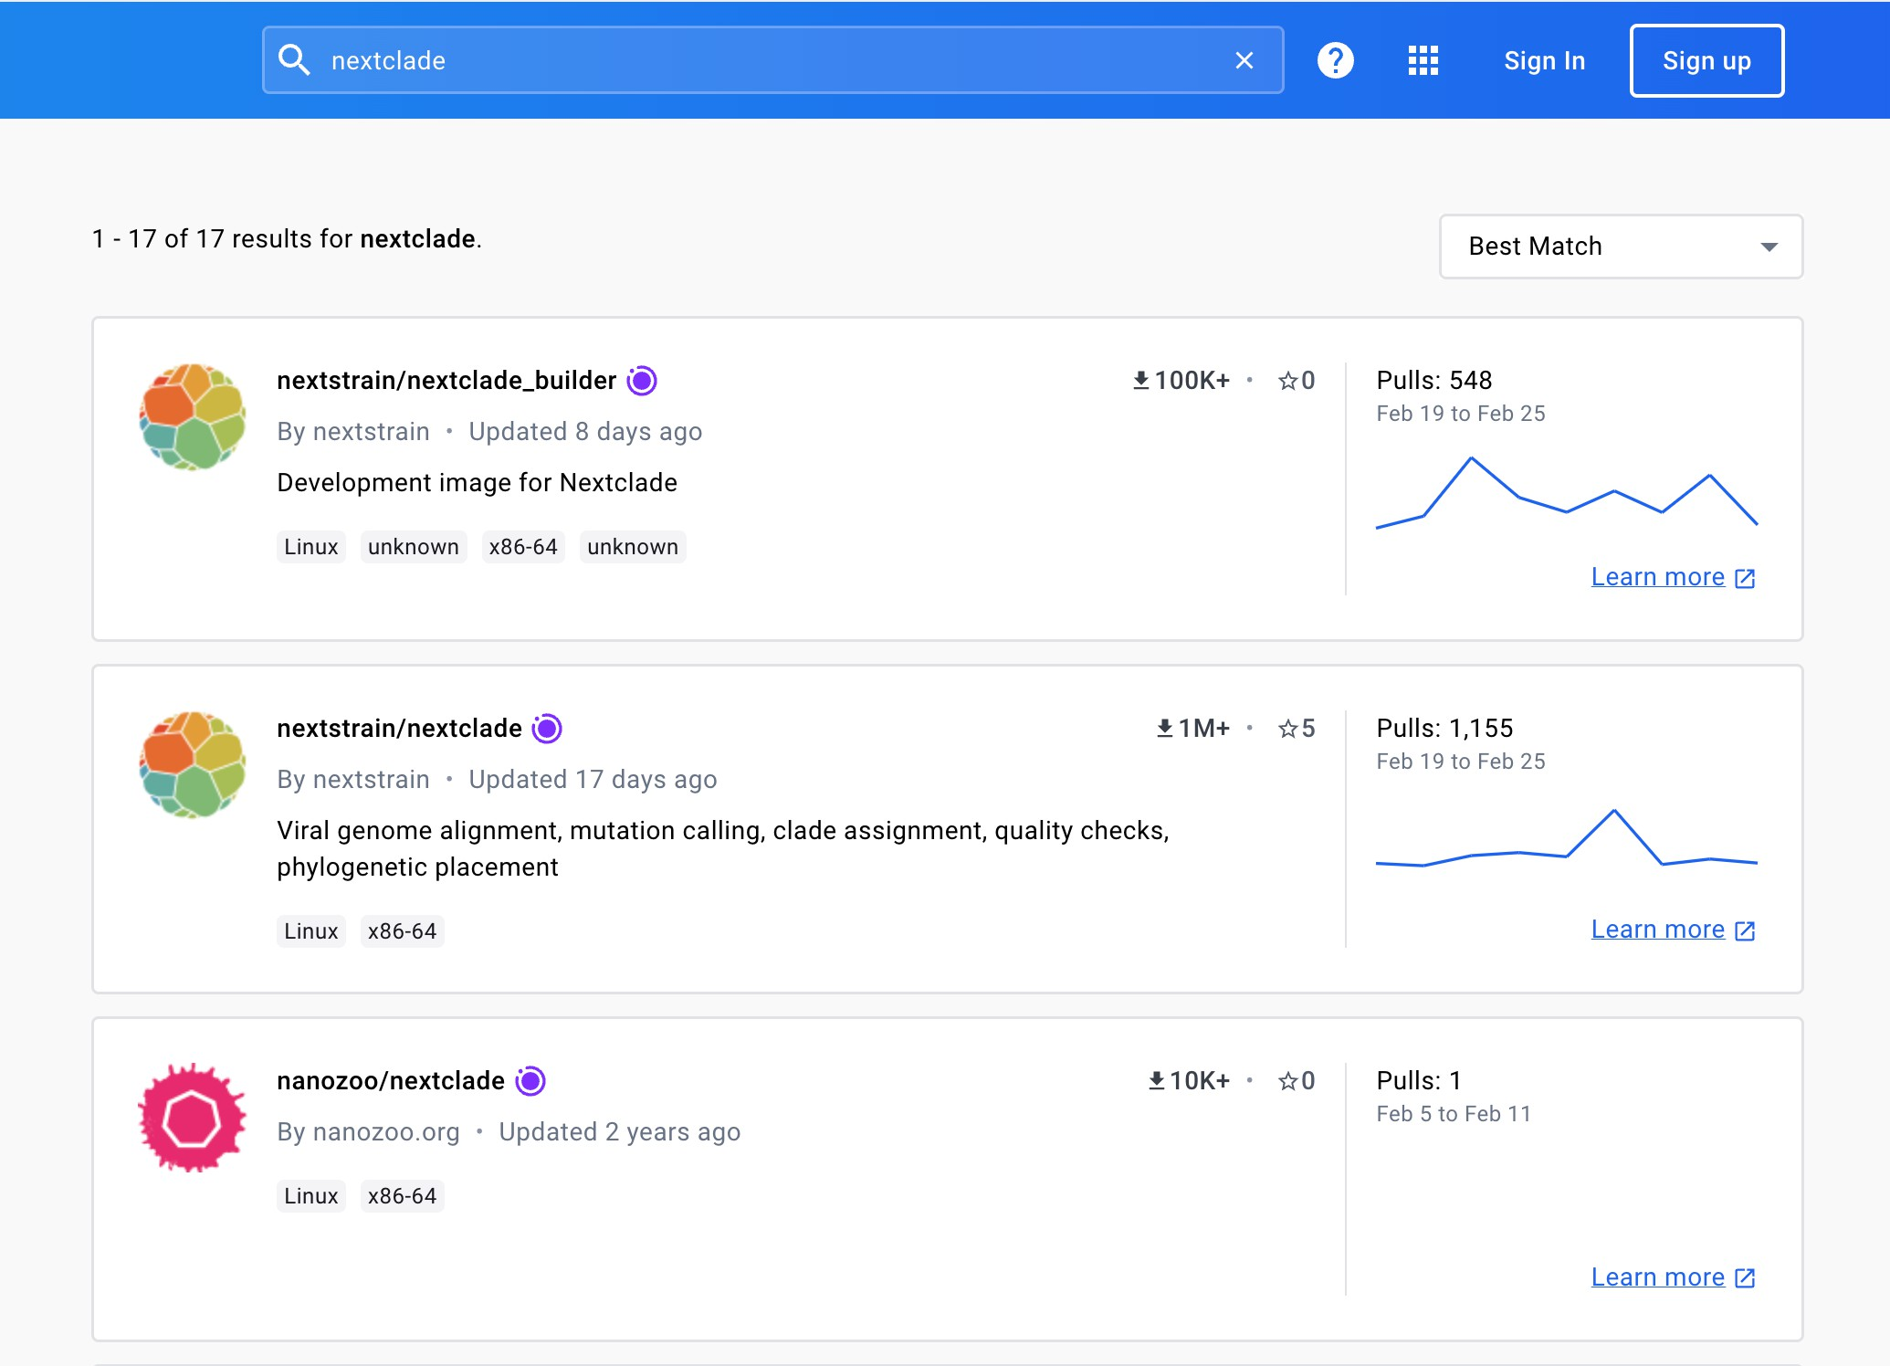
Exercise 1: Search for the best image for nextclade in the docker hub

Slide 19
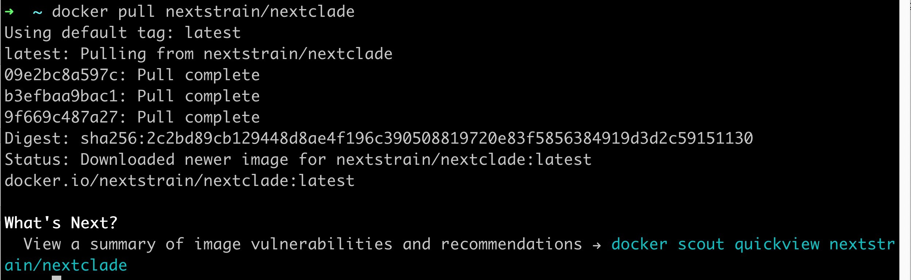

Slide 20
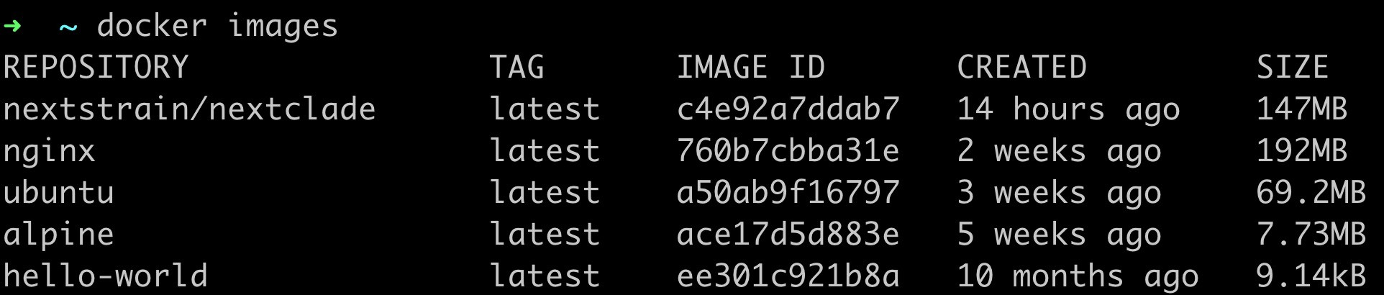
Listing images
docker images
20

Slide 21
Docker run
To run container from the pulled docker image:
Docker run [options] <image name> [image argurments]
21

Slide 22
Detached mode
Containers can run in the background when adding –d in the running command, for example
docker run –d alpine
Docker prints out the ID of the container, so that you can access it later
22

Slide 23
Exercise: Run galaxy
The image is called bgruening/galaxy-stable.
The galaxy image listens on port 80 inside the container.
Run the container in the background:
docker run -d -p 80:80 bgruening/galaxy-stable
23

Slide 24
Port mapping
Docker containers are free to listen on whatever ports to want to, for example port 80/443 for web requests
However, these ports are not available on the host machine unless you use
docker run -p host:container <IMAGE NAME>
This command means "map port 8080 inside this container to port 80 on the host machine
docker run -p 80:8080 <IMAGE NAME>
Note that the host port and container port can be the same, and this is quite common
24

Slide 25
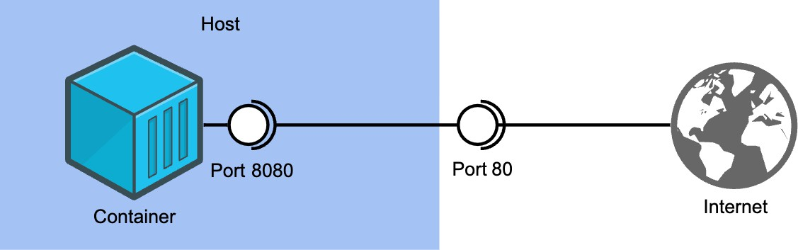
To access the container server run: http://localhost:80
Courtesy: https://www.melbournebioinformatics.org.au/tutorials/tutorials/docker/media/#10
25

Slide 26
Listing running containers
List all running containers
docker ps
List terminated containers
docker ps –a
The IDs that are shown can be useful for other docker commands like
docker stop and docker exec
26

Slide 27
Docker stop
Ordinarily, you can press ctrl+c to stop a container currently running in your terminal.
However, if the container is running in the background (with -d), or refuses to close, you can use docker stop
docker stop <CONTAINER ID>
Use docker stop if you to close the currently running Galaxy Docker container
Hint: use docker ps if you've forgotten the container's ID
27

Slide 28
Volumes and Bind Mounts
By default, Docker containers cannot access data on the host system. This means
You can't use host data in your containers
All data stored in the container will be lost when the container exits
You can solve this in two ways:
-v /path/in/host:/path/in/container: This bind mounts a host file or directory into the container. Writes to one will affect the other. Note that both paths have to be absolute paths, so you often want to use`pwd`/some/path
-v volume_name:/path/in/container. This mounts a named volume into the container, which will live separately from the rest of your files. This is preferred, unless you need to access or edit the files from the host
28

Slide 29
Exercise
you need to store the logs for your Galaxy image on your host system using a bind mount
The Galaxy container stores its logs in /home/galaxy/logs
What command do you run?
Hint: You will want to run the container in detached mode
Once you have done this, ls the directory you mounted into the container to verify that you have the logs
29

Slide 30
Exercise Solution
docker run -d –p 80:80 -v `pwd`/galaxy_logs:/home/galaxy/logs bgruening/galaxy- stable
30

Slide 31
Running command inside a container
You can run a command inside a running container using:
docker exec <CONTAINER ID> <COMMAND>
For example:
docker exec bd2ac6cce96f ls
You can also run an interactive bash session inside the container with:
docker exec -it bd2ac6cce96f bash
31

Slide 32
Running command inside a container
Start another Galaxy container using:
docker run -d -p 80:80 bgruening/galaxy-stable
Make a quick edit to the Galaxy homepage, which is located at /etc/galaxy/web/welcome.html
Edit the welcome message in some way, save the file, and then check to see if your changes worked on the website.
Re-open the webpage in separate window or browser to get it to refresh
32

Slide 33
Running command inside a container
Run docker ps to find the container ID
docker exec -it <CONTAINER_ID> bash
Now, run nano /etc/galaxy/web/welcome.html (or vim!) and save the file
33

Slide 34
Summary
To runs a Docker container from docker image:
docker [-d] [-p host:container] [-v /host/path:/container/path] run <IMAGE NAME>
To displays all installed images:
docker images
To displays all containers on the system:
docker ps [-a]
To run a command inside a running container:
docker exec <CONTAINER ID> <COMMAND>
To stop a running container:
docker stop <CONTAINER ID>
34

Slide 35
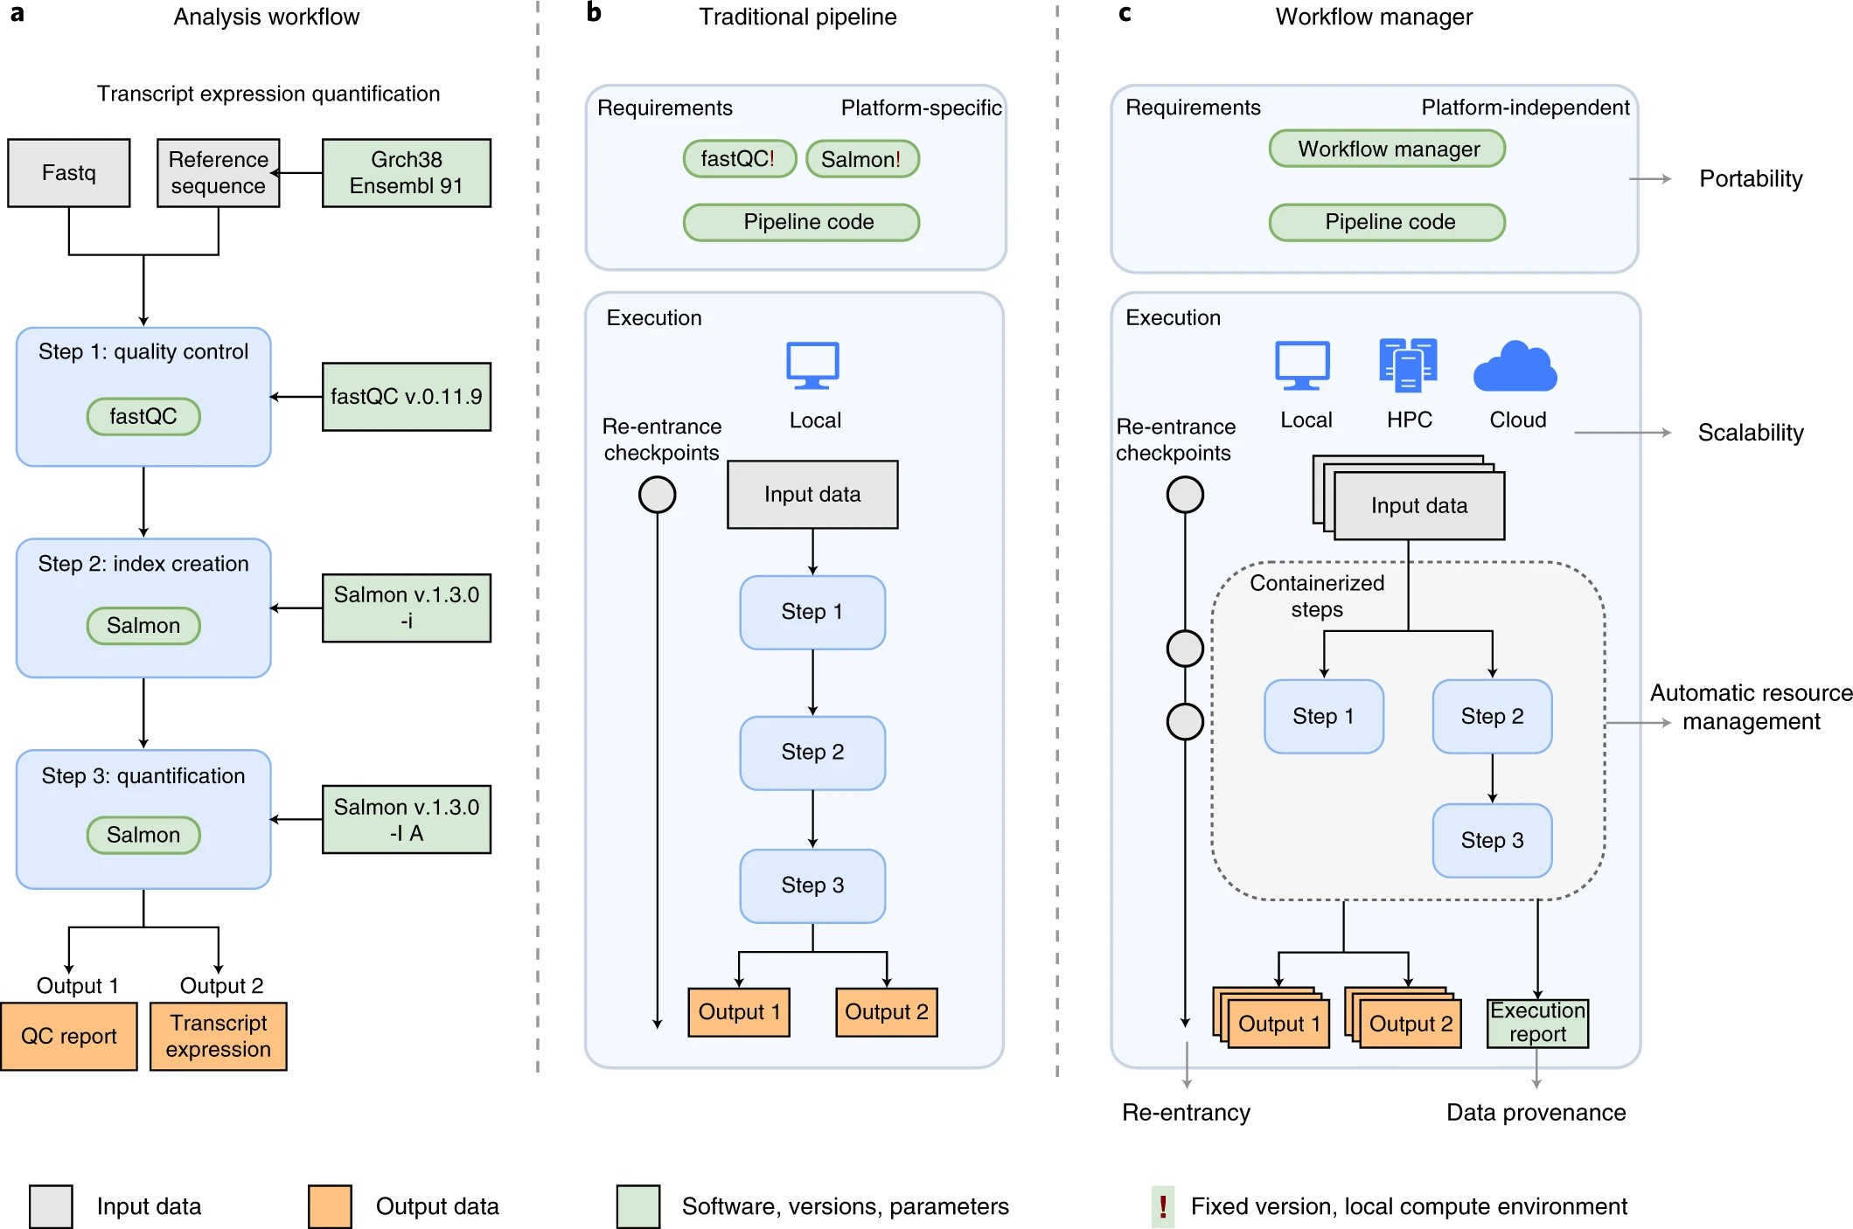
Workflows
35

Slide 36
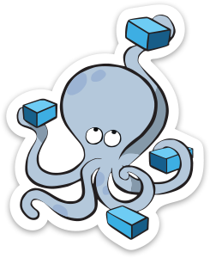
Section 1:
What is Docker
What is Docker Not
Basic Docker Commands Dockerfiles
Section 3:
Networking
Section 2:
Anatomy of a Docker image Docker volumes
Section 4:
Docker compose / stacks
Demo
36

Slide 37
Section 1: What is Docker
Basic Docker Commands Dockerfiles
37

Slide 38
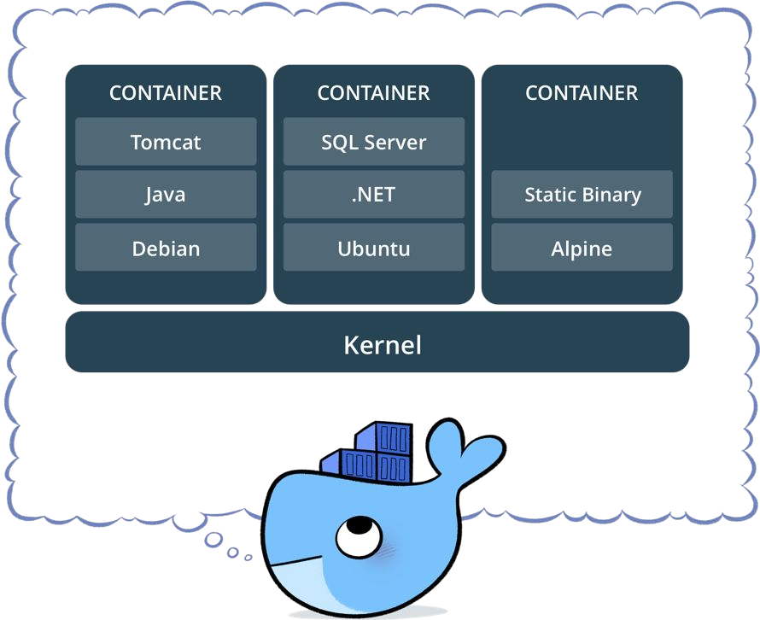
What is a container?
Standardized packaging for software and dependencies
Isolate apps from each other
Share the same OS kernel
Works for all major Linux distributions
Containers native to Windows Server 2016
38

Slide 39
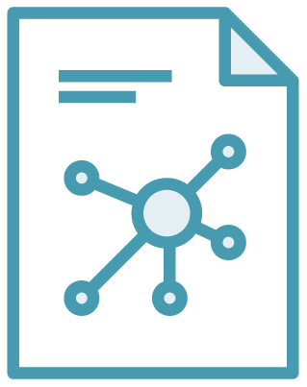

The Role of Images and Containers
Docker Image
Docker Container
Example: Ubuntu with Node.js and Application Code
Created by using an image. Runs your application.
39

Slide 40


Docker containers are NOT VMs
Easy connection to make
Fundamentally different architectures
Fundamentally different benefits
Maquina Virtual
Contenedores
40
40

Slide 41
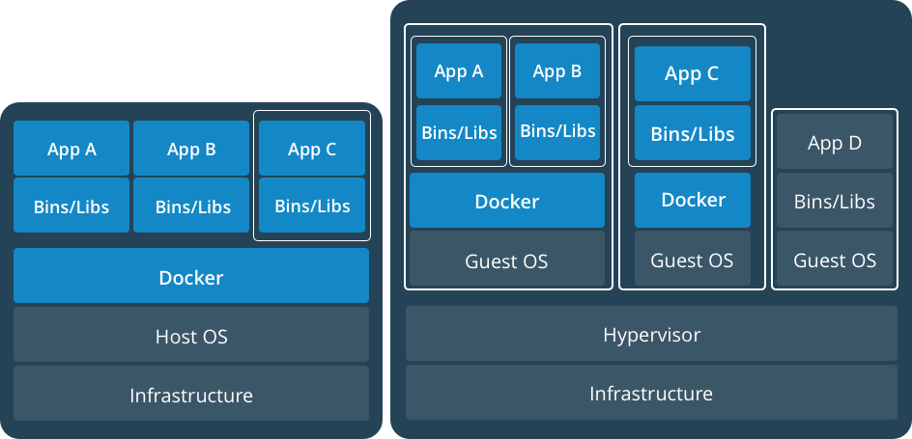
Docker Containers Versus Virtual Machines
App 1
App 2
Bins/Libs
Bins/Libs
Guest OS
Guest OS
App 1
App 2
Bins/Libs
Bins/Libs
Hypervisor
Docker Engine
Host Operating System
Host Operating System
Virtual Machines
Docker Containers
41

Slide 42
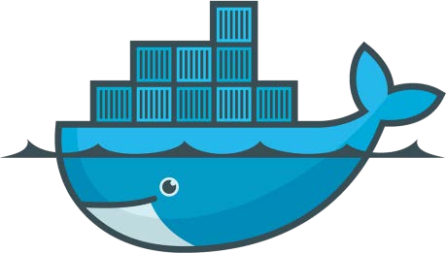
Lightweight, open, secure platform
Simplify building, shipping, running apps
What Is Docker?
Runs natively on Linux or Windows Server
Runs on Windows or Mac Development machines (with a virtual machine)
Relies on "images" and "containers"
42

Slide 43
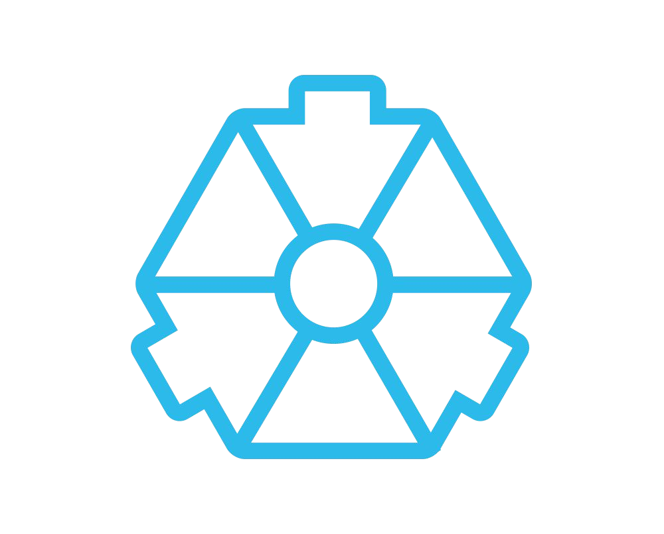
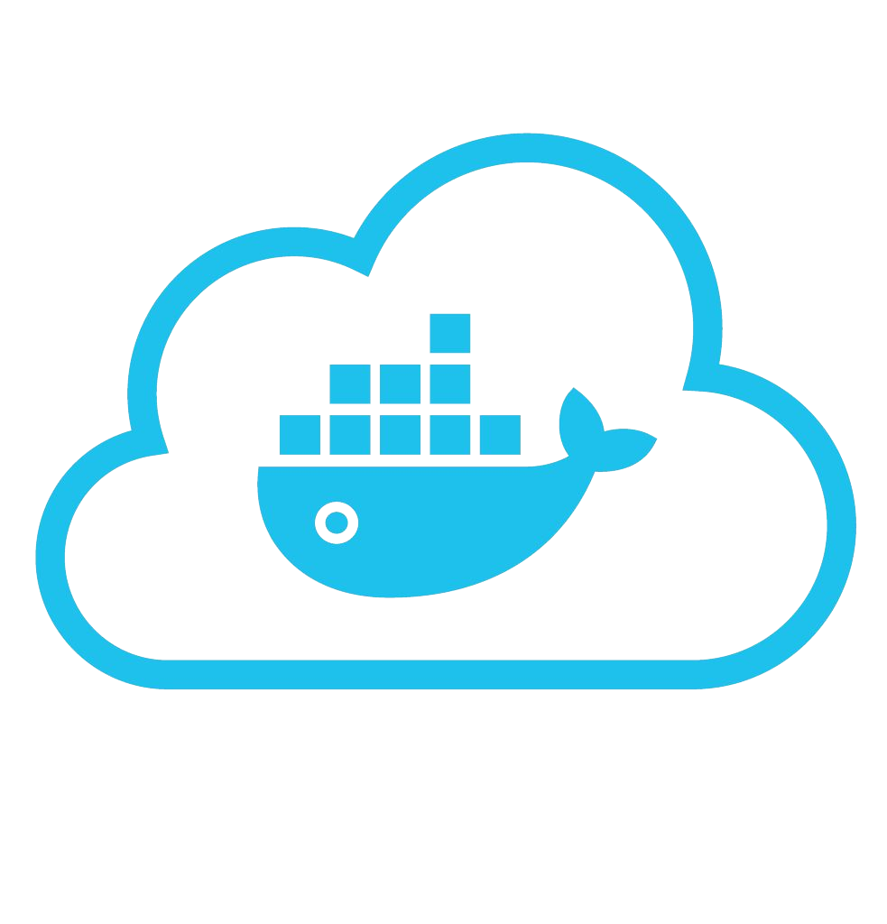










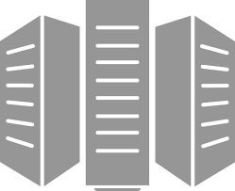



Using Docker: Build, Ship, Run Workflow
Developers IT Operations
BUILD
Development Environments
SHIP
Create & Store Images
RUN
Deploy, Manage, Scale
43

Slide 44




Some Docker vocabulary
Docker Image
The basis of a Docker container. Represents a full application
Docker Container
The standard unit in which the application service resides and executes
Docker Engine
Creates, ships and runs Docker containers deployable on a physical or virtual, host locally, in a datacenter or cloud service provider
Registry Service (Docker Hub(Public) or Docker Trusted Registry(Private))
Cloud or server based storage and distribution service for your images
44

Slide 45
Basic Docker Commands
$ docker image pull node:latest
$ docker image ls
$ docker container run –d –p 5000:5000 –-name node node:latest
$ docker container ps
$ docker container stop node(or <container id>)
$ docker container rm node (or <container id>)
$ docker image rmi (or <image id>)
$ docker build –t node:2.0 .
$ docker image push node:2.0
$ docker --help
45

Slide 46
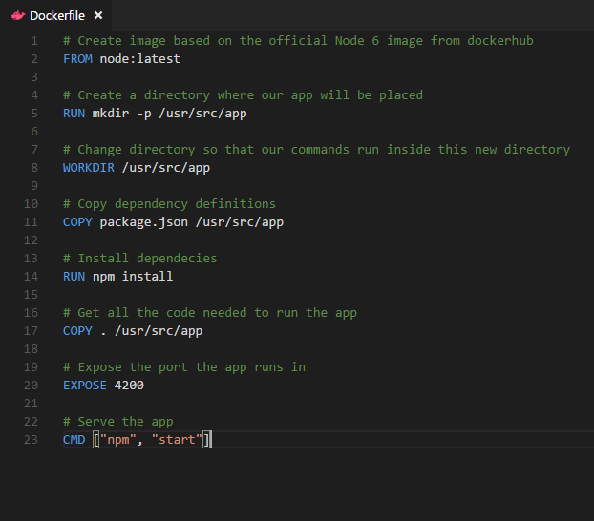
Dockerfile – Linux Example
Instructions on how to build a Docker image
Looks very similar to “native” commands
Important to optimize your Dockerfile
14
46

Slide 47
Section 2:
Anatomy of a Docker Container Docker Volumes
Volume Use Cases
47

Slide 48
Let’s Go Back to Our Dockerfile
48

Slide 49
Each Dockerfile Command Creates a Layer
…
EXPOSE
COPY
WORKDIR
RUN
FROM
Kernel
49

Slide 50
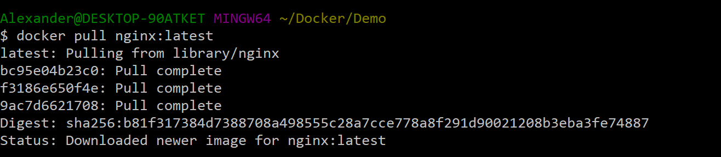
Docker Image Pull: Pulls Layers
50

Slide 51
Docker Volumes
Volumes mount a directory on the host into the container at a specific location
Can be used to share (and persist) data between containers
Directory persists after the container is deleted
Unless you explicitly delete it
Can be created in a Dockerfile or via CLI
51

Slide 52
Why Use Volumes
Mount local source code into a running container
docker container run -v $(pwd):/usr/src/app/ myapp
Improve performance
− As directory structures get complicated traversing the tree can slow system performance
Data persistence
52

Slide 53

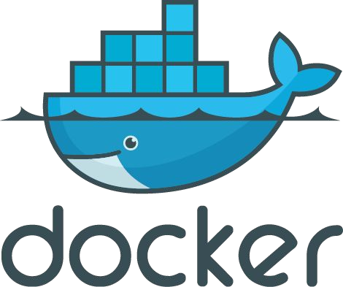
Section 3: Networking
53

Slide 54

What is Docker Bridge Networking
Docker host
Docker host
Cntnr 1
Cntnr 2
Cntnr 3
Cntnr 4
Cntnr 5
Cntnr 6
Cntnr 7
bridgenet1
bridgenet2
bridgenet3
docker network create -d bridge --name bridgenet1
54

Slide 55


Docker Bridge Networking and Port Mapping
Docker host 1
Host port
Container port
Cntnr1
10.0.0.8
:80
$ docker container run -p 8080:80 ...
Bridge
172.14.3.55
:8080
L2/L3 physical network
55

Slide 56
Section 4: Docker Compose
56

Slide 57




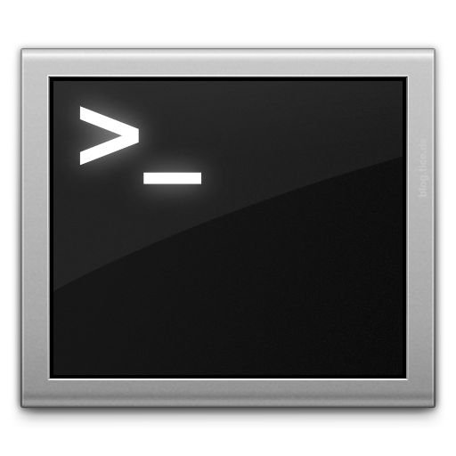







Docker Compose: Multi Container Applications
Build and run one container at a time
Manually connect containers together
Must be careful with dependencies and start up order
Define multi container app in compose.yml file
Single command to deploy entire app
Handles container dependencies
Works with Docker Swarm, Networking, Volumes, Universal Control Plane
49
57

Slide 58

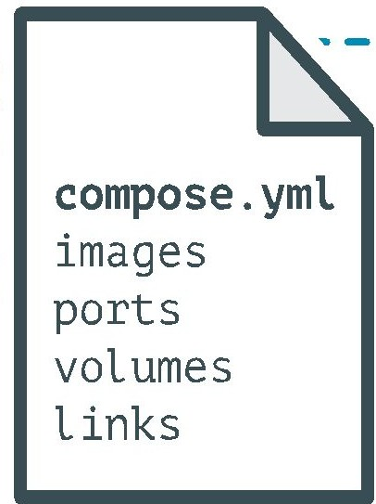
Docker Compose: Multi Container Applications
version: '2' # specify docker-compose version
# Define the services/containers to be run
services:
angular: # name of the first service
build: client # specify the directory of the Dockerfile
ports:
- "4200:4200" # specify port forewarding
express: #name of the second service
build: api # specify the directory of the Dockerfile
ports:
- "3977:3977" #specify ports forewarding
database: # name of the third service
image: mongo # specify image to build container from
ports:
- "27017:27017" # specify port forewarding
58

Slide 59
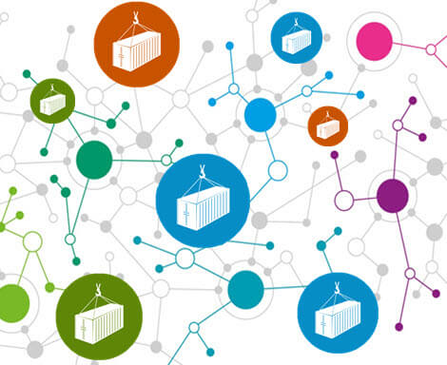
Docker Compose: Scale Container Applications
59

Slide 60



Demo
Angular
Node.js/Express
Mongo DB
60

Slide 61
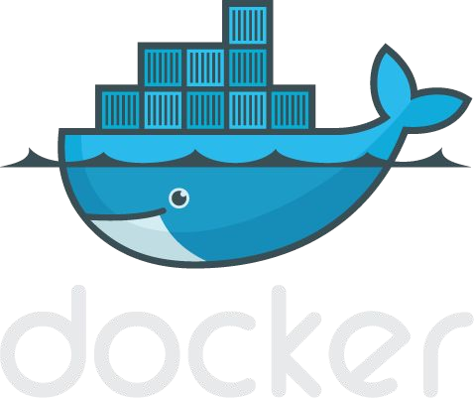
61

